Slide 1
Test Case BASICS and UNIT TEsting
Lecture #3

Slide 2
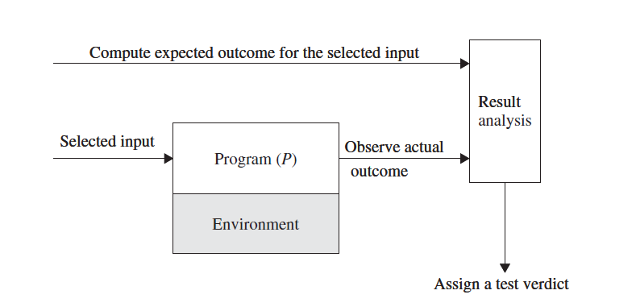
Different activities in Program Testing

Slide 3
SOURCES OF INFORMATION FOR TEST CASE SELECTION
Requirements and functional specifications
Source code
Input and output domains
Operational profile
Fault model

Slide 4
CONCEPT OF COMPLETE TESTING
Complete, or exhaustive, testing means there are no undiscovered faults at the end of the test phase.
Complete Testing is impossible because:
Large domain (valid in one state and invalid in another)
The design issues may be too complex to completely test.
It may not be possible to create all possible execution environments of the system.

Slide 5
Test Report
A test report must be written after analyzing the test result. The motivation for writing a test report is to get the fault fixed if the test revealed a fault.
A test report contains the following items to be informative:
Explain how to reproduce the failure.
Analyze the failure to be able to describe it.
A pointer to the actual outcome and the test case, complete with the input, the expected outcome, and the execution environment.

Slide 6
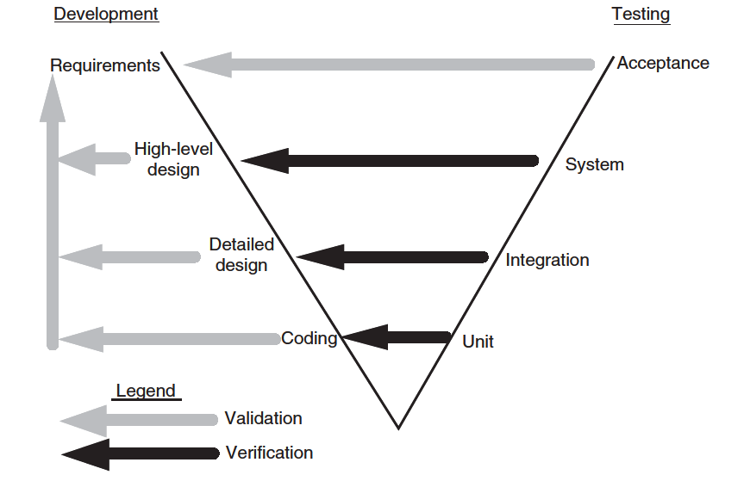
Development and Testing in V-model

Slide 7
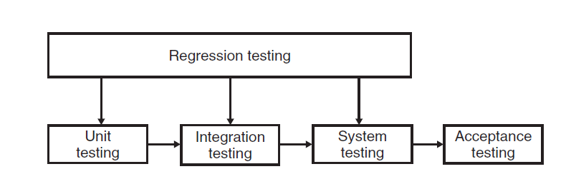
Regression Testing

Slide 8
Acceptance Testing
User acceptance testing (UAT)
Business acceptance testing (BAT)

Slide 9
UNIT TESTING

Slide 10
Concept of Unit Testing
Static Unit Testing
Code is examined over all possible behaviors that might arise during run time
Code of each unit is validated against requirements of the unit by reviewing the code
Dynamic Unit Testing
A program unit is actually executed and its outcomes are observed
One observe some representative program behavior, and reach conclusion about the quality of the system
Static unit testing is not an alternative to dynamic unit testing
Static and Dynamic analysis are complementary in nature
In practice, partial dynamic unit testing is performed concurrently with static unit testing
It is recommended that static unit testing be performed prior to the dynamic unit testing

Slide 11
Static Unit Testing
In static unit testing code is reviewed by applying techniques:
Inspection: It is a step by step peer group review of a work product, with each step checked against pre-determined criteria
Walkthrough: It is review where the author leads the team through a manual or simulated executed of the product using pre-defined scenarios
The idea here is to examine source code in detail in a systematic manner
The objective of code review is to review the code, and not to evaluate the author of the code
Code review must be planned and managed in a professional manner
The key to the success of code is to divide and conquer
An examiner inspect small parts of the unit in isolation
nothing is overlooked
the correctness of all examined parts of the module implies the correctness of the whole module

Slide 12
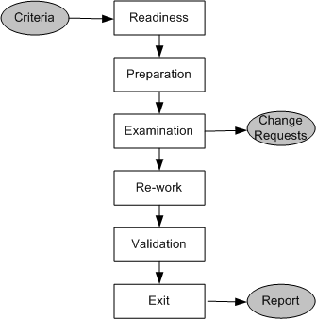
Static Unit Testing (Code Review)
Step 1: Readiness
Criteria
Completeness
Minimal functionality
Readability
Complexity
Requirements and design documents
Roles
Moderator
Author
Presenter
Record keeper
Reviewers
Observer
Step 2: Preparation
List of questions
Potential Change Request (CR)
Suggested improvement opportunities
Figure 3.1: Steps in the code review process

Slide 13
Static Unit Testing (Code Review)
A Change Request (CR) includes the following details:
Give a brief description of the issue
Assign a priority level (major or minor) to a CR
Assign a person to follow it up
Set a deadline for addressing a CR
Step 3: Examination
The author makes a presentation
The presenter reads the code
The record keeper documents the CR
Moderator ensures the review is on track
Step 4: Re-work
Make the list of all the CRs
Make a list of improvements
Record the minutes meeting
Author works on the CRs to fix the issue
Step 5: Validation
CRs are independently validated
Step 6: Exit
A summary report of the meeting minutes is distributes

Slide 14
Static Unit Testing (Code Review)
The following metrics can be collected from a code review:
The number of lines of code (LOC) reviewed per hour
The number of CRs generated per thousand lines of code (KLOC)
The number of CRs generated per hour
The total number of hours spend on code review process

Slide 15
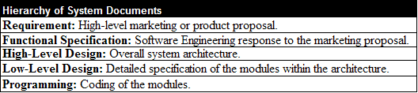
Static Unit Testing (Code Review)
The code review methodology can be applicable to review other documents
Five different types of system documents are generated by engineering department
Requirement
Functional Specification
High-level Design
Low-level Design
code
In addition installation, user, and trouble shooting guides are developed by technical documentation group

Slide 16
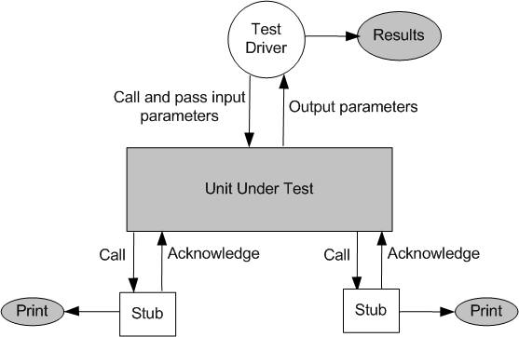
Dynamic Unit Testing
The environment of a unit is emulated and tested in isolation
The caller unit is known as test driver
A test driver is a program that invokes the unit under test (UUT)
It provides input data to unit under test and report the test result
The emulation of the units called by the UUT are called stubs
It is a dummy program
The test driver and the stubs are together called scaffolding
The low-level design document provides guidance for selection of input test data
Figure 3.2: Dynamic unit test environment

Slide 17
Dynamic Unit Testing
Selection of test data is broadly based on the following techniques:
Control flow testing
Draw a control flow graph (CFG) from a program unit
Select a few control flow testing criteria
Identify a path in the CFG to satisfy the selection criteria
Derive the path predicate expression from the selection paths
By solving the path predicate expression for a path, one can generate the data
Data flow testing
Draw a data flow graph (DFG) from a program unit and then follow the procedure described in control flow testing.
Domain testing
Domain errors are defined and then test data are selected to catch those faults
Functional program testing
Input/output domains are defined to compute the input values that will cause the unit to produce expected output values

